Slide 1
Evolving Convolutional Neural Network Architectures using Cartesian Genetic Programming
Aniruddha Das, Milind Lingineni, Sanath Nagaraj

Slide 2
What is CGP?
CGP is a highly efficient and flexible form of Genetic Programming that encodes a graph representation of a computer program¹.
Using a graph representation is very flexible as many computational structures can be represented as graphs¹.
CGP represents computational structures (mathematical equations, circuits, computer programs etc) as a string of integers¹.

Slide 3
What can CGP be used for? ¹
Machine Learning
Neural Networks
Artificial Intelligence
Data Mining
Financial prediction
Function optimization
Classification
Electronic circuit design
Medical diagnostics
Evolutionary art and music
And more!

Slide 4
Advantages of CGP¹
CGP typically finds good solutions very efficiently in few evaluations.
In all comparisons CGPs performance has been shown to be highly competitive with other GP methods.
CGP is extremely efficient to decode.
Easy to trace the flow of data through the network.
Saves resources by identifying active and inactive nodes – ignores inactive nodes.
CGP does not bloat like other forms of GP

Slide 5
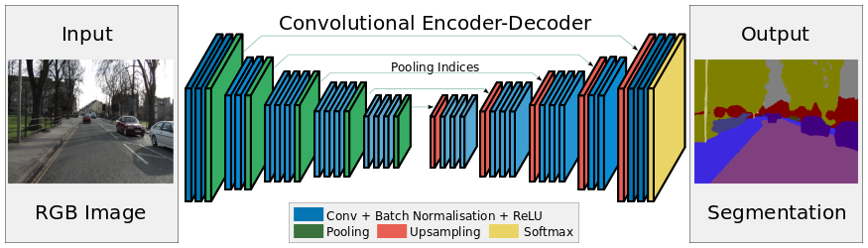
Project Intro
Our aim is to use CGP and EMADE to evolve Convolutional Neural Network architectures for image classification problems.
Motivation:
Large-Scale Evolution of Image Classifiers by Esteban Real, et. al.

Slide 6
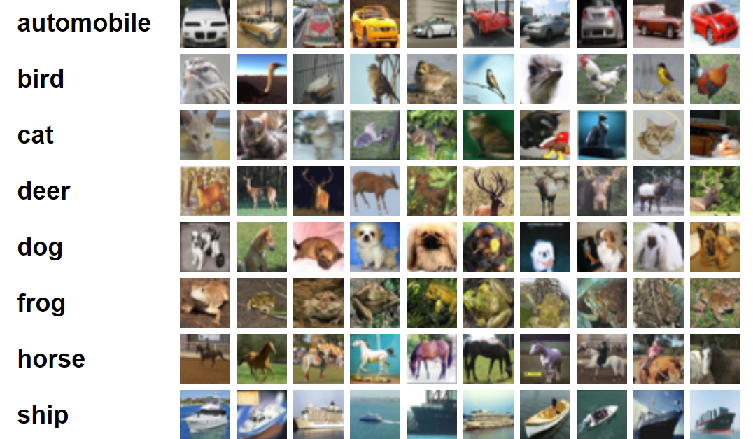
Measuring Performance
Evaluate our individuals against the CIFAR-10 and CIFAR-100 baselines.

Slide 7
Other considerations
Collaboration with Deep Learning team.
Use GCP/AWS cloud compute to run evolution.
Explore seeding with known architectures/weights.
Think of ways to use weights of previous evolutionary predecessor.
Translation of dataset sample performance to whole dataset performance.

Slide 8
Timeline
9/18: Understand CGP and whether Tensorflow will be enough to implement it.
9/25: Clone Joel's repo and run his CGP-CNN framework successfully.
10/2: Meet up and discuss with deep learning group.
Tasks to be completed:
Run CGP-CNN on CIFAR-10 / CIFAR-100.
Expand to image classification Kaggle competition.
Potentially add capabilities to run object detection or instance segmentation tasks.

Slide 9


Questions?

Slide 10


References
1: http://www.cartesiangp.co.uk/

